Slide 1
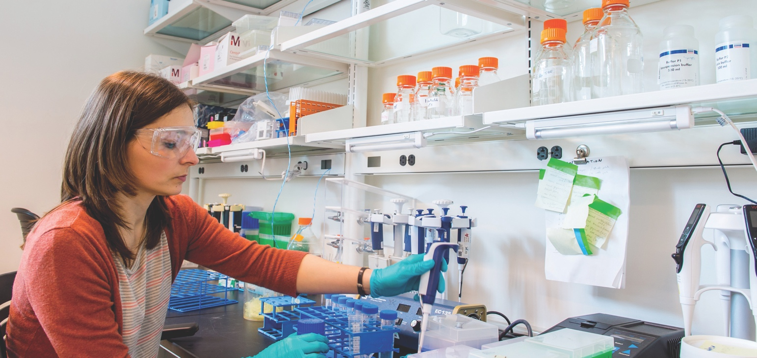
Towards Super-Resolution Structural Characterization of Biomacromolecules in Solution
Jiahui Chen
Postdoc Appointee
Structural Science group, X-ray Science Division
Argonne National Laboratory
May 13, 2022

Slide 2
outline
Introduction
Understand Structure of Biomacromolecules
SAXS, Ultra-Wide Angles Scattering Experiments, and PDF analysis
Benchmark Sample: Mo₁₃₂, Cyclodextrin
Application: Chain Conformation, Counterion Condensation
Summary and Looking Forward

Slide 3
Introduction

Slide 4
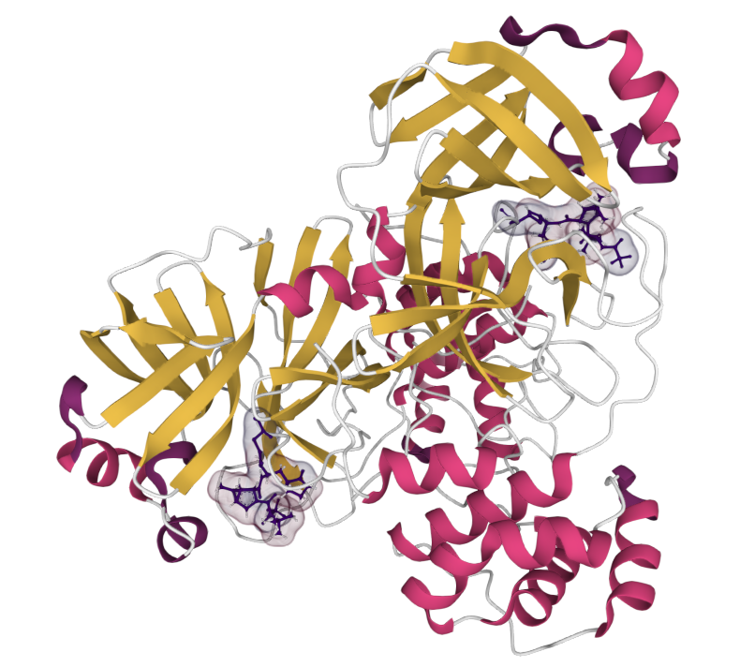
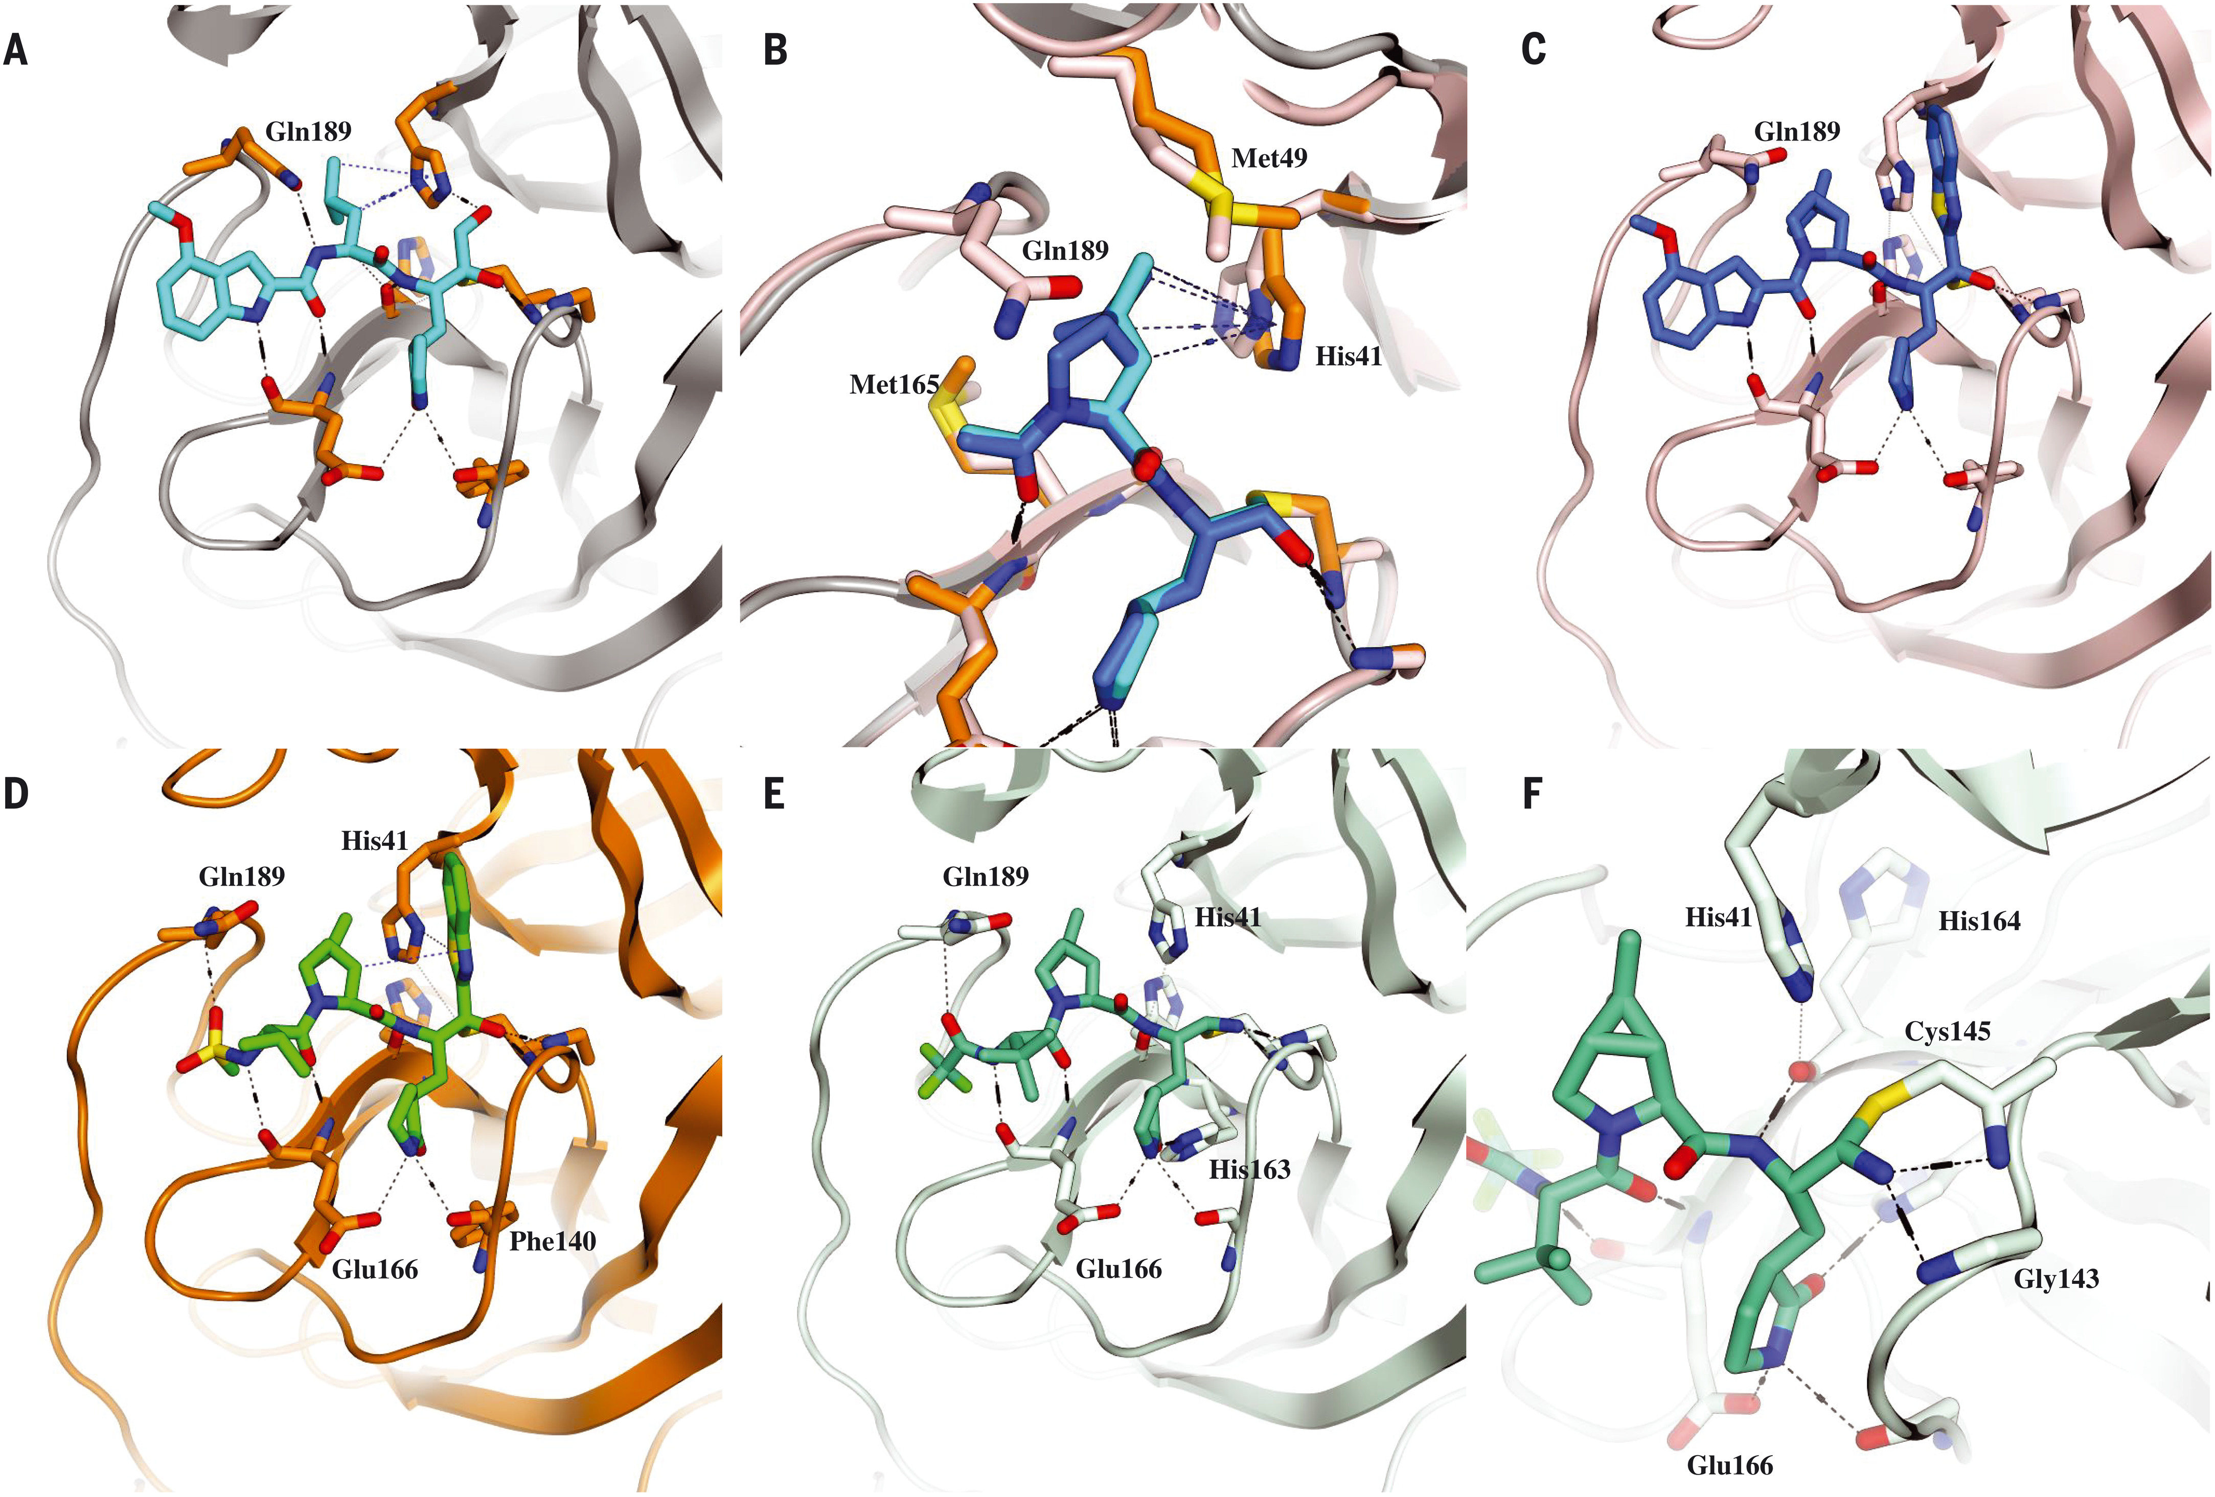
understand the structure and function of biomacromolecules
Binding of PF-00835231 (left, initial inhibitor candidate) and PF-07321332 (middle, one of component in Pfizer’s PAXLOVID™) with SARS-COV-2 main protease dimer (right)
Understanding of the structures of biomacromolecule is essential for structure-function relationship knowledge and rational drug design.
https://en.wikipedia.org/wiki/Coronavirus_spike_protein
Science.374 (2021): 1586-1593.

Slide 5
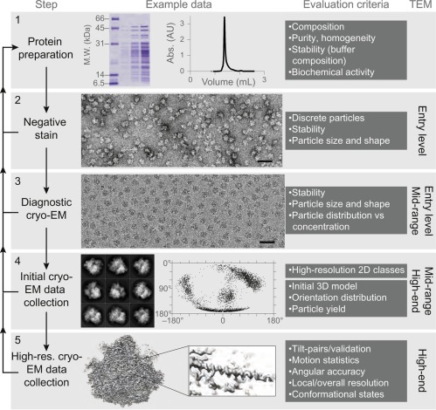
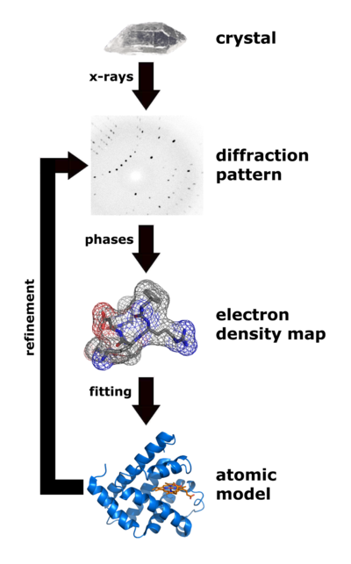
High resolution characterization: X-ray Crystallography and Cryo-EM
Require significant amount of effort to prepare samples.
https://upload.wikimedia.org/wikipedia/commons/7/73/X_ray_diffraction.png
Methods in enzymology 579 (2016): 51-86.

Slide 6
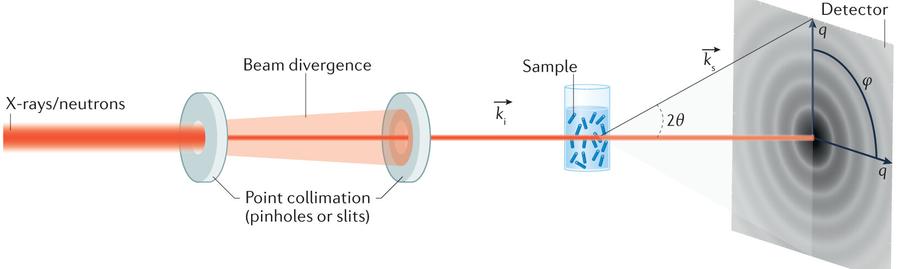
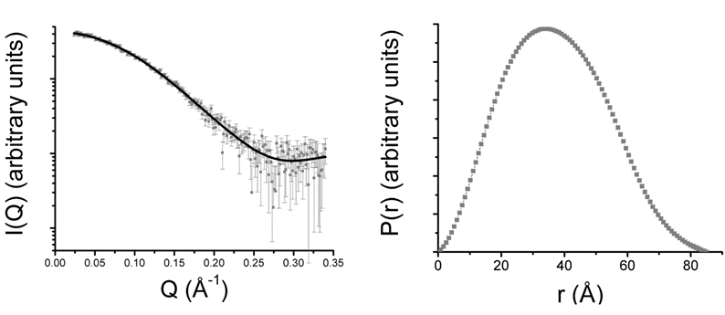
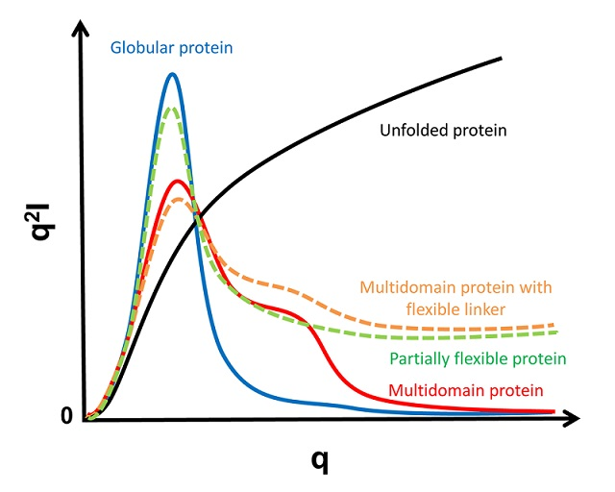
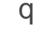
Small angle X-ray Scattering (SAXS)
A common instrumental setup of a small angle scattering experiment.
Credit:
Nat. Rev. Methods Primers 1, (2021): 70
Pair Density Distribution Function (PDDF) analysis
Fourier transformation
Credit:
Biophys J. 110 (2016):2185
Kratky plot

Slide 7
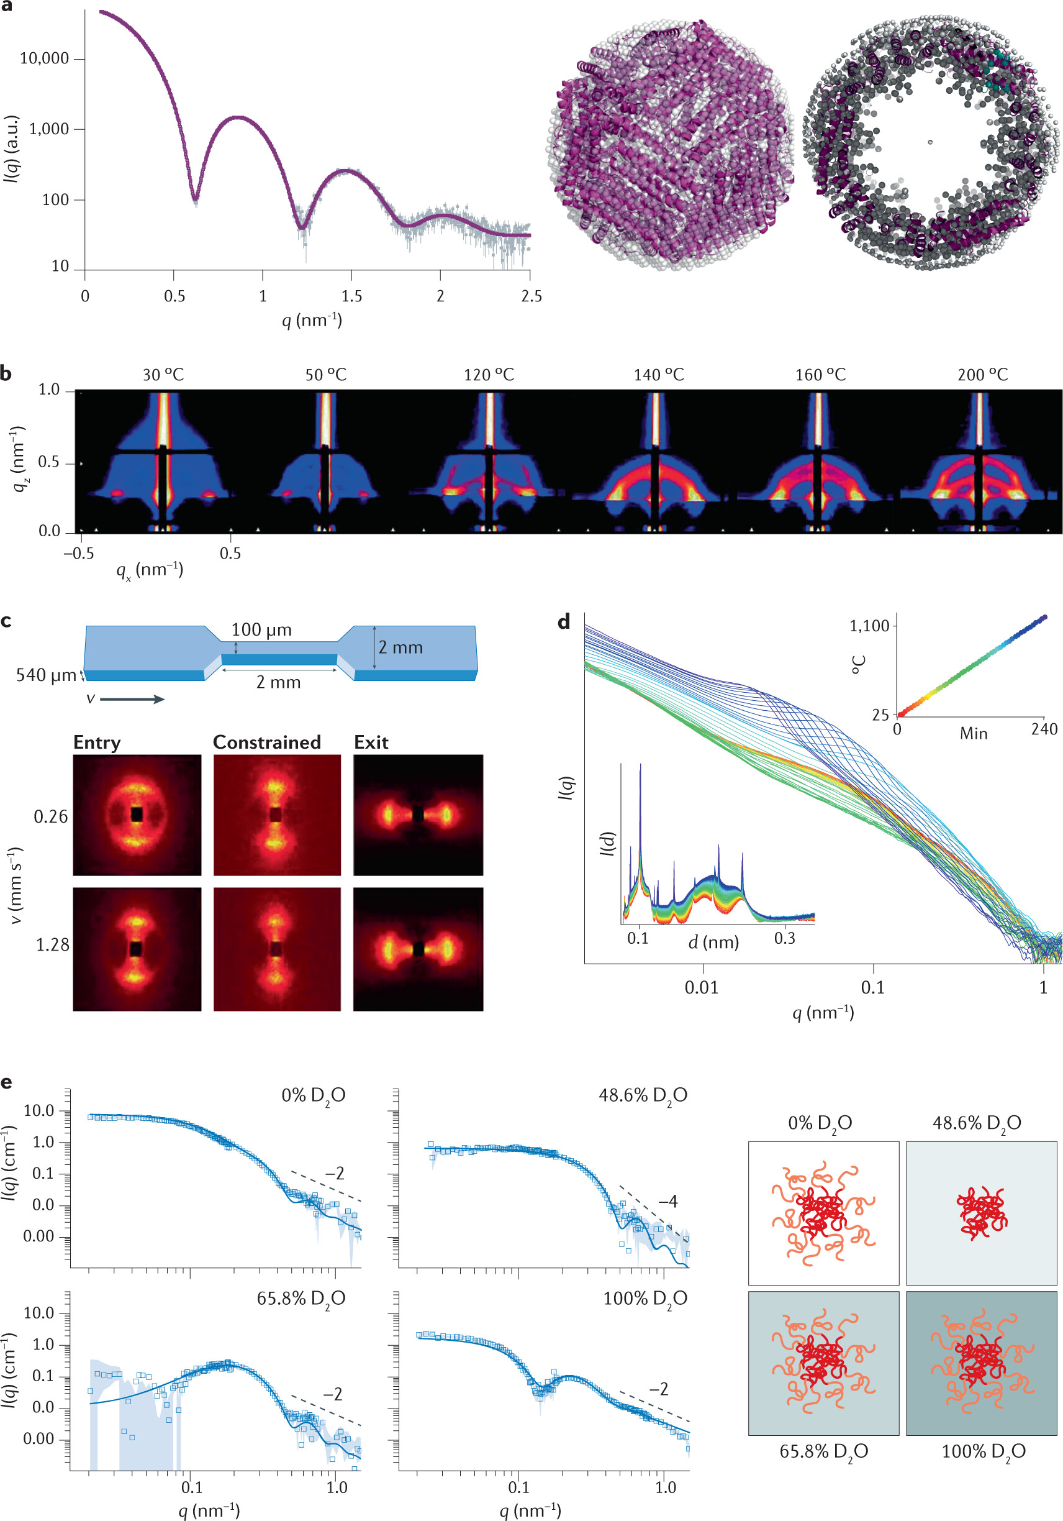
Small angle X-ray Scattering (SAXS)
A reconstructed 3D structure from SAXS data
I(0):
Molecular weight and concentration
q
Information that can be extracted from SAXS data.
Credit: Nature Reviews Methods Primers 1, (2021): 70

Slide 8
Small angle X-ray Scattering (SAXS)
Disadvantages:
Low resolution: 1~2 nm. Continuum assumption on solvent and solute.
Radiation damage can be significant for biomacromolecules. The damaged sample frequently adheres to capillary cell and affect all following experiment
Usually require previous knowledge to analyze the data (high resolution structure from MD, Cryo-EM, NMR, or crystallography)
Advantages:
Require little to no sample preparation.
Rapid data collection.
In vitro measurements at physiological condition is possible.

Slide 9
From SAXS to WAXS
Most of SAXS experiments on biomacromolecular solutions only take q_{max} < 0.3 Å⁻¹ , corresponding to a resolution ~ 2 nm.
Scattering profile will contain more information with higher q_{max}.

Slide 10
SAXS and Ultra-Wide Angles Scattering Experiments for Atomic PDF analysis

Slide 11
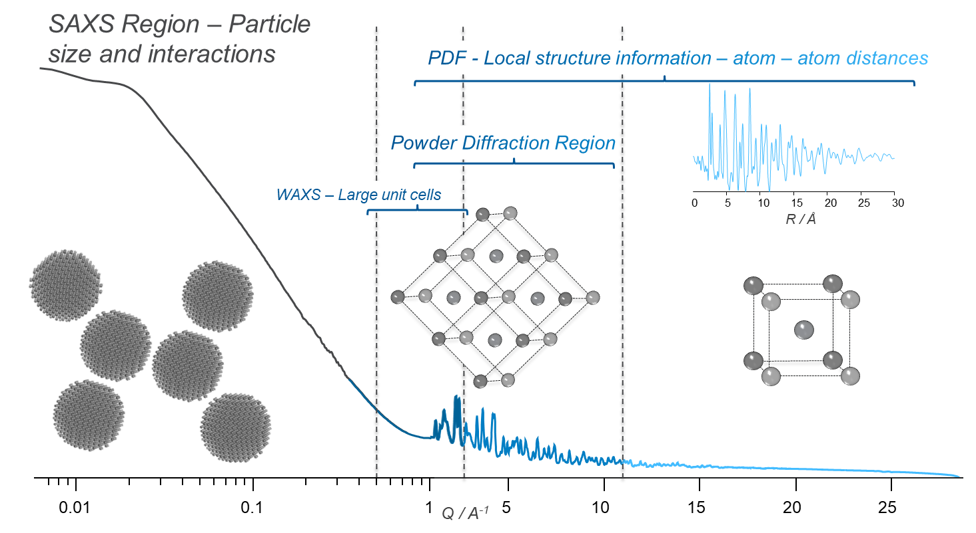
Information in the extended q-range data
SAXS
PXRD
PDF

Slide 12
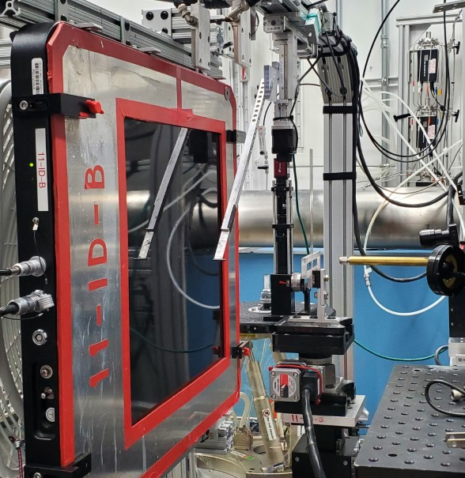
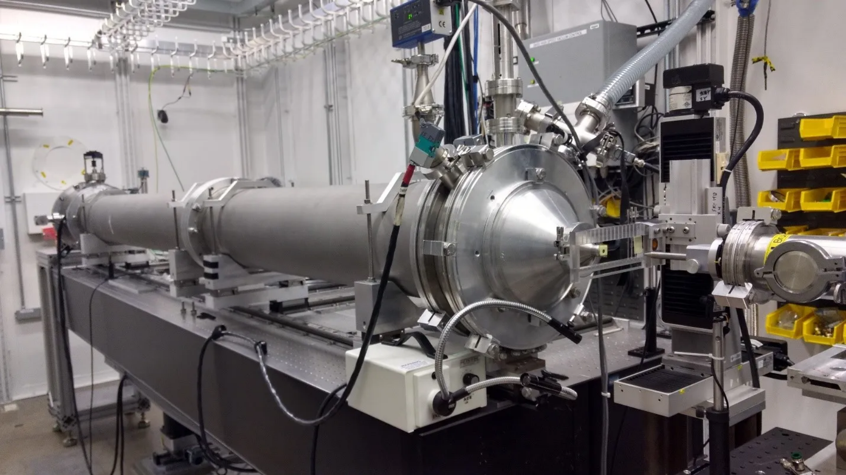
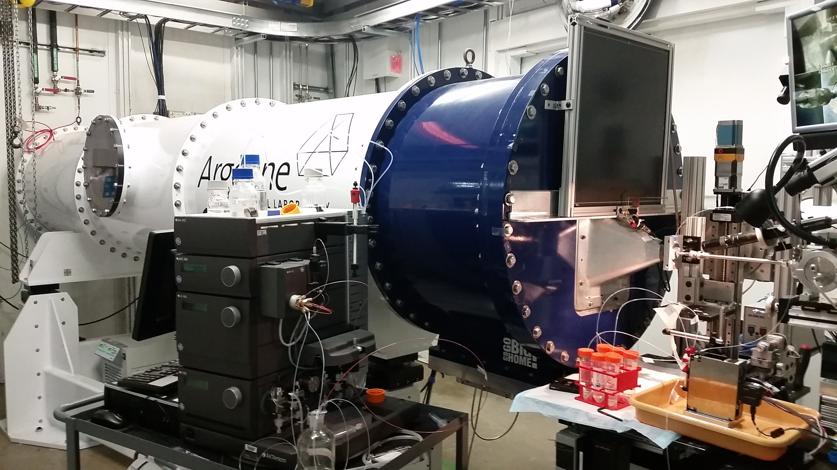
Combination of saxs and waxs instruments
15 ID-D, SAXS
q-range: 0.04~1.8 Å⁻¹
@ 20 Kev
NSF’s ChemMatCARS
12 ID-B, SEC-SAXS
q-range: 0.001~2.5 Å⁻¹
@ 12 Kev
11 ID-B, WAXS
q-range: 1.5 ~ 23 Å⁻¹
@ 58 Kev
Advanced Photon Source

Slide 13
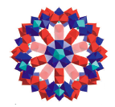
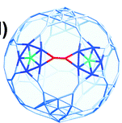
Benchmark sample-Mo₁₃₂
2.9 nm
High-Z Elements,
Rigid, Well-Defined Structure.
Size comparable to a protein
[Mo₁₃₂O₃₇₂(H₂O)₇₂(CH₃CO₂)₃₀]
I-q(WAXS)

Slide 14
Benchmark sample-Mo₁₃₂
Merge with SAXS
Fourier Transform
I-q(SAXS+WAXS)
PDF Profile

Slide 15
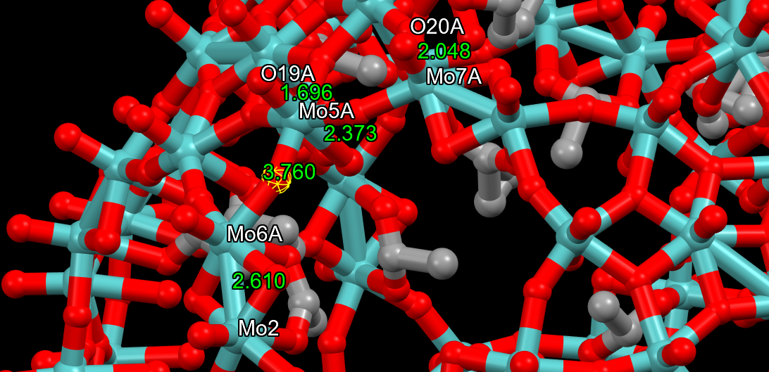
Peak position at low-r: apparent bond length
Features at high-r: Particle size and shape
2.9 nm

Slide 16
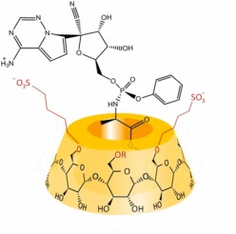
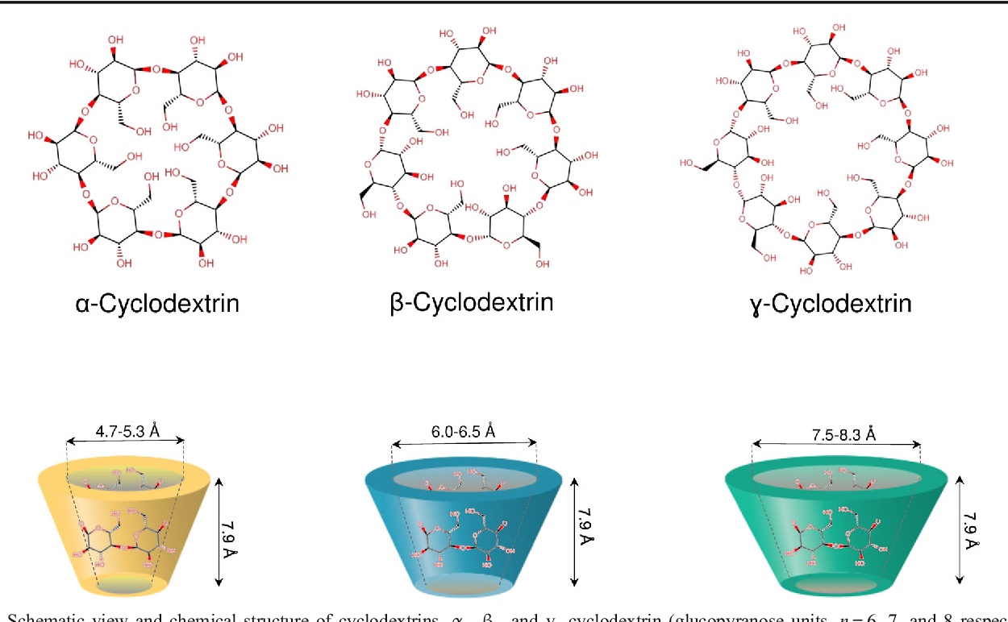
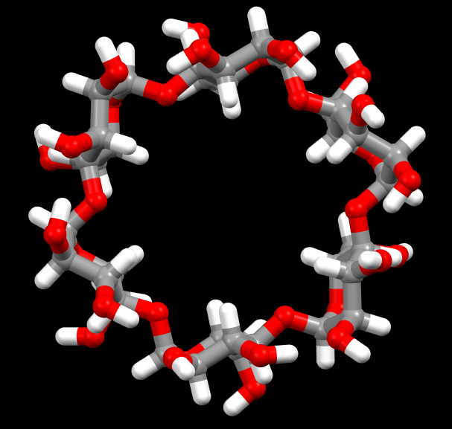
Benchmark on PDF analysis of Biomacromolecules
Crystalline structure
Inclusion complexes of a βCD derivative with Remdesivir
12 Å
Cyclodextrins are widely used in small molecule drug formulation to increase solubility and change metabolism.
However, the inclusive complex usually do not crystallize, which makes it difficult to characterize the structure by conventional crystallography methods.
Low-Z material, Well-defined and Rigid Conformation
Credit: Food. Bioproc. Tech. 12, (7) (2019): 1157-1173.
Credit: J Pharm Biomed Anal. 209, (2022);114482.

Slide 17
Scattering data
I-q(WAXS)
I-q(SAXS+WAXS)

Slide 18
Atomic PDF analysis
Intra-glucosidic ring covalent bonding
Fourier Transform
Macrocycle Conformation
I-q(SAXS+WAXS)
PDF Profile

Slide 19
structure determination and refinement

Slide 20
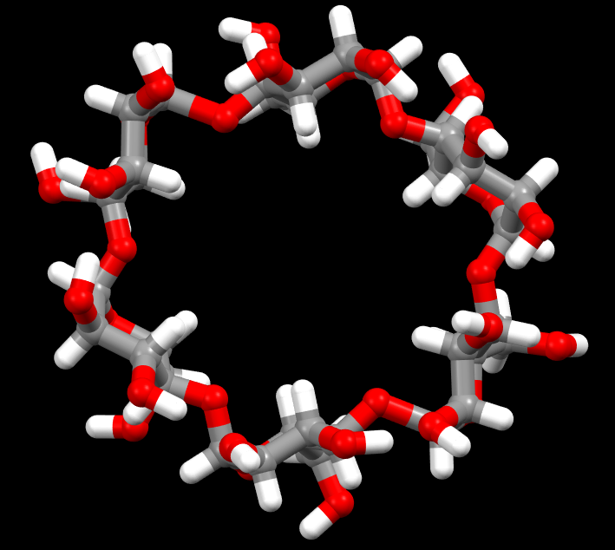
Chain conformation
 | Center / Å | Area | FWHM | Bond
1 | 1.04 | 0.604 | 0.174 | C-H/O-H
2 | 1.44 | 2.620 | 0.269 | C-C/C-O
3 | 2.41 | 1.322 | 0.214 | Two Bonds
4 | 2.82 | 0.551 | 0.224 | Hydrogen Bond/Para-Positions in the Glucosidic Ring
5 | 3.69 | 0.429 | 0.249 | O2-C4, O3-C5…..
6 | 4.22 | 0.345 | 0.207 | O2-C5, O3-O5…..
Refined structure
Initial structure

Slide 21
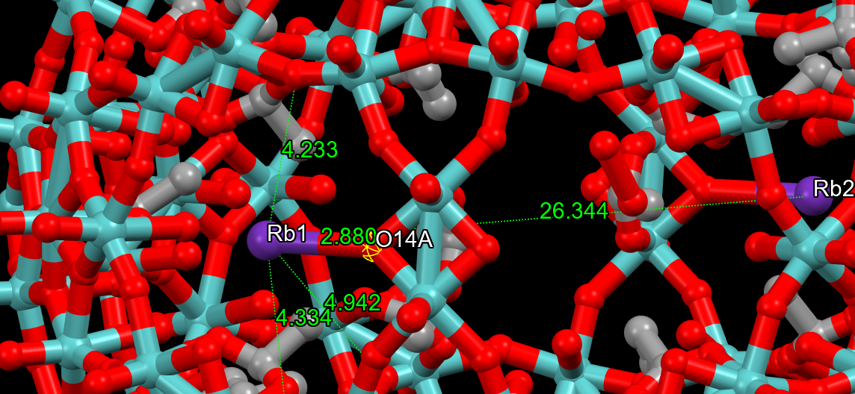
Counterion association

Slide 22
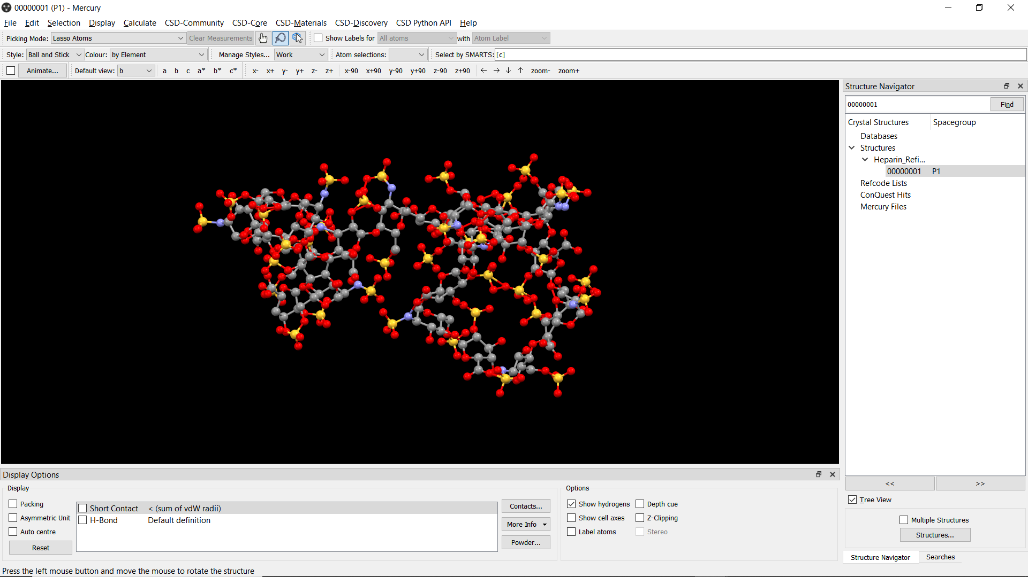
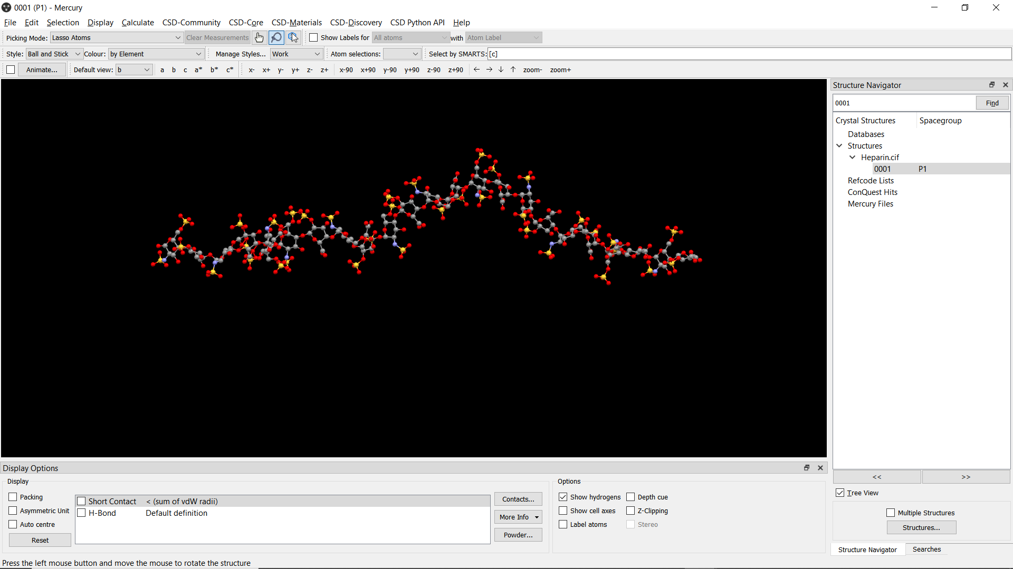
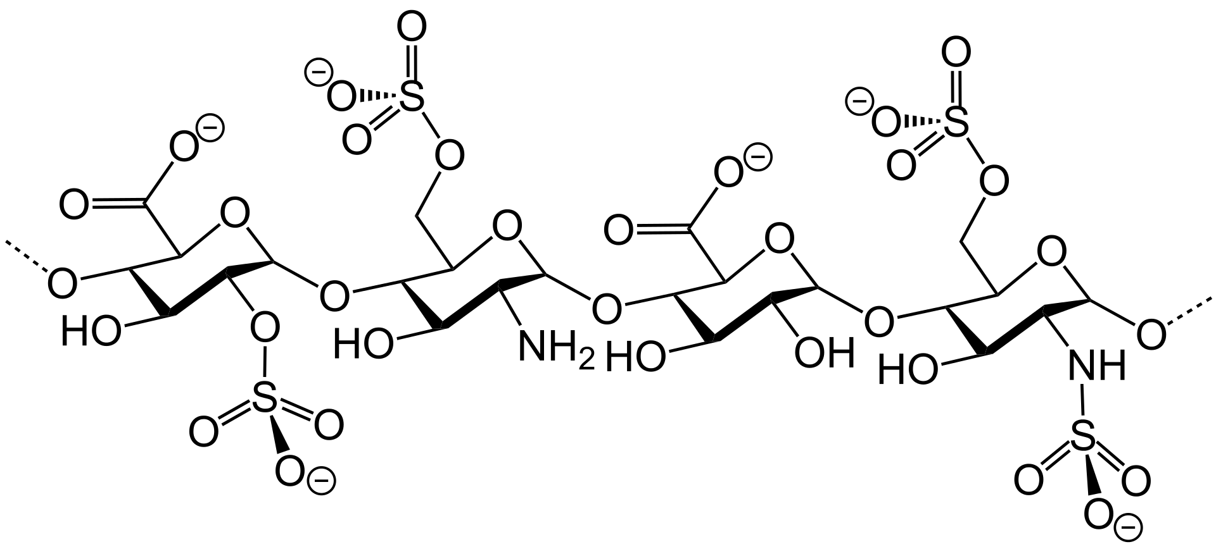
Counterion association and Chain conformation
Sodium Counterion Association
Refinement result
Initial structure, determined at low concentration and low ionic strength
50
125 mg/ml Heparin sodium salt

Slide 23
Improved resolution compared with SAXS PDF profile
Short range correlation
Particle size and shape
WAXS+SAXS PDF profile
SAXS only PDF profile (< 1 Å⁻¹)
Information about short range correlation is missing in the SAXS

Slide 24
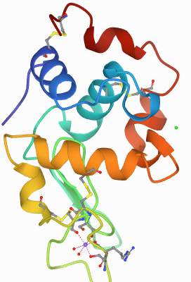
Looking forward to protein

Slide 25
Looking forward to protein

Slide 26
Summary
Combined SAXS and WAXS beamlines to achieve wide q-range coverage on biomacromolecule solution X-ray scattering measurement.
Atomic PDF analysis is a promising method to make use of WAXS data to determine and refine structures for biomacromolecules in pharmaceutically relevant environment.

Slide 27




acknowledgement
Dr. Olaf J. Borkiewicz
Dr. Xiaobing Zuo
Dr. Uta Ruett
Dr. Fan Zhang
Dr. Igor Levin
Dr. Alexander Grishaev
Dr. Mrinal K. Bera

Slide 28
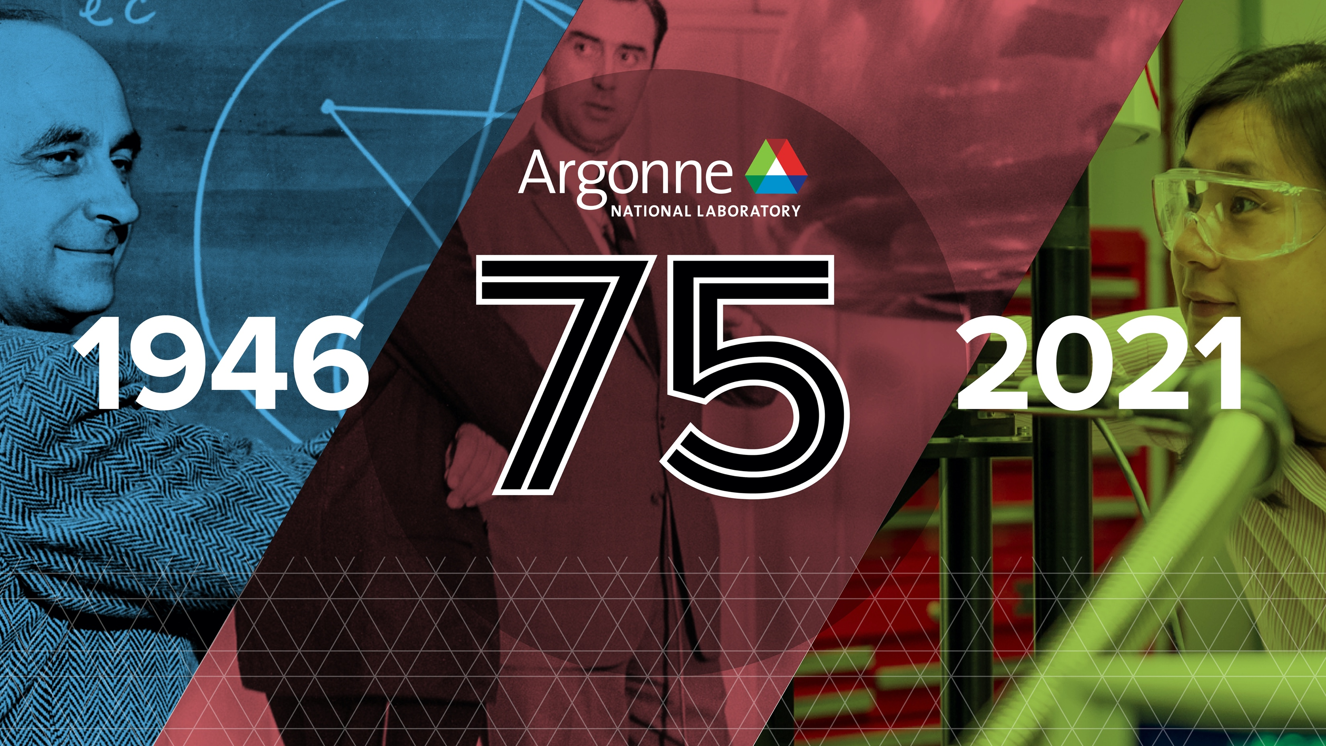

Slide 29
Alpha CD
Simulated (crysol) and Experimental I-q Data
Simulated | Observed
q / Å⁻¹ | q / Å⁻¹
0.79 | 0.83
1.42 | 1.52
1.97 | 1.98
2.54 | 2.58
3.38 | 3.43
5.26 | 5.22
7.9 | 7.9
9.0 | 9.0
11.1 | 11.0
13.7 | 13.7

Slide 30
Alpha CD
G(r) Extracted from Simulated and Experimental Data
The simulated one from a structure without considering atom thermal motion, resulting in sharper peaks

Slide 31
Atomic Structure Function
Various corrections: q Space Resampling, Data Smoothing, Linear Interpolate q to 0….
I(q) normalized by atomic form factor
Structure Function
(different from the structure factor used in SAXS community)

Slide 32
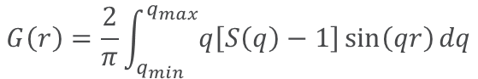
G(r) profile
$$G\left(r\right)=\frac{2}{π}\int_{q_{min}}^{q_{max}}{q\left[S\left(q\right)−1\right]\sin\left(qr\right)dq}$$
Intra-glucosidic ring covalent bonding
Fourier transformation
Hydration layer
Inter-glucosidic ring conformation
Optional: Dump q[S(q)-1] to suppress high-frequency noise

Slide 33
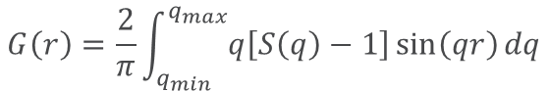
Why do need both SAXS and WAXS data?
WAXS:
q_{max} determines the r-space resolution:
$∆r ≈\frac{π}{q_{max}}$, for a q_{max} $≈$ 20 Å⁻¹, $∆r≈$ 0.15 Å⁻¹
Also, q_{max} determines amplitude of termination artifacts:
Ideally, S(q) converge to 1 at q_{max}. If not, the sudden step down of S(q) at q_{max} will give a sinc-function like ripples convoluted with G(r).
$$G\left(r\right)=\frac{2}{π}\int_{q_{min}}^{q_{max}}{q\left[S\left(q\right)−1\right]\sin\left(qr\right)dq}$$

Slide 34
Effect of q_{max} on the extraction of G(r)
The effect of q_{max} on peak positions has been observed on pair distribution function analysis of water as well.
q_{min} = 10 to 27 Å⁻¹
Credit:
J. Chem. Phys. 138, 074506 (2013)

Slide 35
Effect of q_{max} on the extraction of G(r)
PDF profile extracted from experimental scattering data of 50 mg/ml ACD solution.

Slide 36
Effect of q_{min} on the extraction of G(r)
SAXS:
Fourier transformation of SAXS part gives the baseline of the PDF profile at high-r.
PDF profile extracted from experimental scattering data of 50 mg/ml ACD solution.

Slide 37
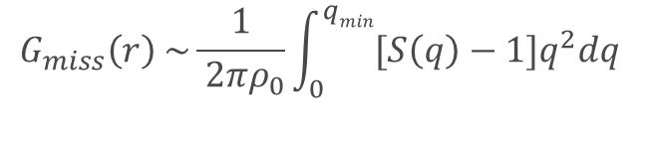
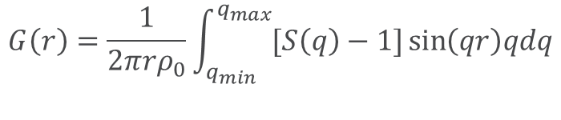
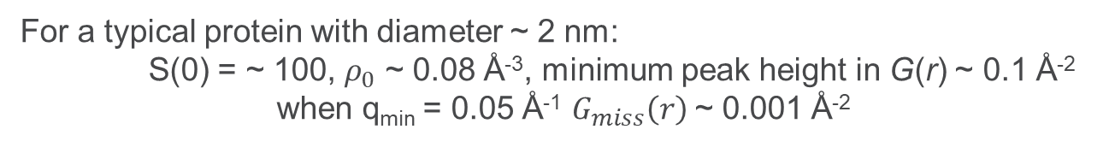
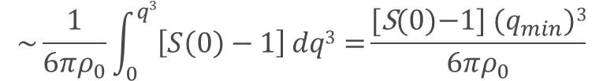
Do we need to extend q_{min}?
$$G\left(r\right)=\frac{1}{2π{rρ}_{0}}\int_{q_{min}}^{q_{max}}{[S\left(q\right)−1]\sin\left(qr\right)qdq}$$
When q ~ 0 (small angle), sin(qr) ~ qr,
S(q³) ~ constant ~ I₀/<b>² (Guinier approximation):
$$G_{miss}\left(r\right) \sim \frac{1}{ 2πρ_{0}}\int_{0}^{qmin}{{[S\left(q\right)−1]q}^{2}\operatorname{dq}{ }}$$
$$\sim \frac{1}{6πρ_{0}}\int_{0}^{q3}{\left[S\left(0\right)−1\right]dq3{=}\frac{\text{[}\text{S}\text{(0)−1] (}q_{min}\text{)}\text{3}}{6πρ_{0}}}$$
should be much smaller than G(r) at any r.
For a typical protein with diameter ~ 2 nm:
S(0) = ~ 100, $ρ_{0}$ ~ 0.08 Å⁻³, minimum peak height in G(r) ~ 0.1 Å⁻²
when q_{min} = 0.05 Å⁻¹ $G_{miss}\left(r\right)$~ 0.001 Å⁻²

Slide 38
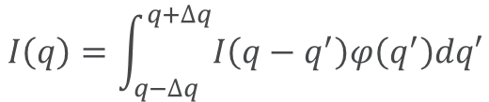
Instrument resolution
$$I\left(q\right)=\int_{q−∆q}^{q+∆q}{I\left(q−q^{′}\right)φ\left(q^{′}\right)dq′}$$
Where $φ\left(q\right)$ is the q resolution function, $∆q$ is the instrument resolution
As for scattering from single particle/amorphous material, there is no sharp Bragg peaks. Therefore, intensity is a continuous function and effect of q resolution is minimum.

Slide 39
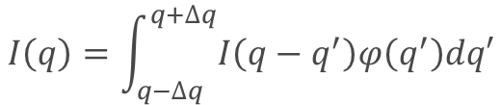
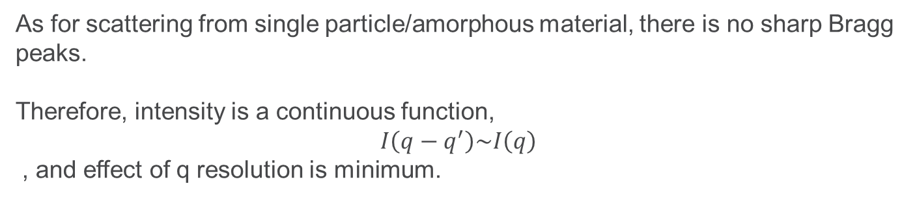
instrument resolution
$$I\left(q\right)=\int_{q−∆q}^{q+∆q}{I\left(q−q^{′}\right)φ\left(q^{′}\right)dq′}$$
Where $φ\left(q\right)$ is the q resolution function, $∆q$ is the instrument resolution
As for scattering from single particle/amorphous material, there is no sharp Bragg peaks.
Therefore, intensity is a continuous function,
$$I\left(q−q^{′}\right)\sim I\left(q\right)$$
, and effect of q resolution is minimum.

Slide 40
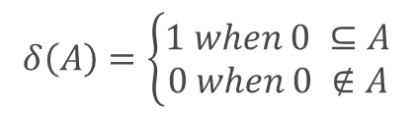
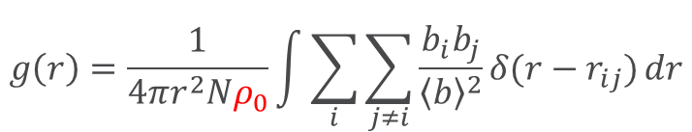
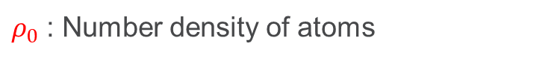
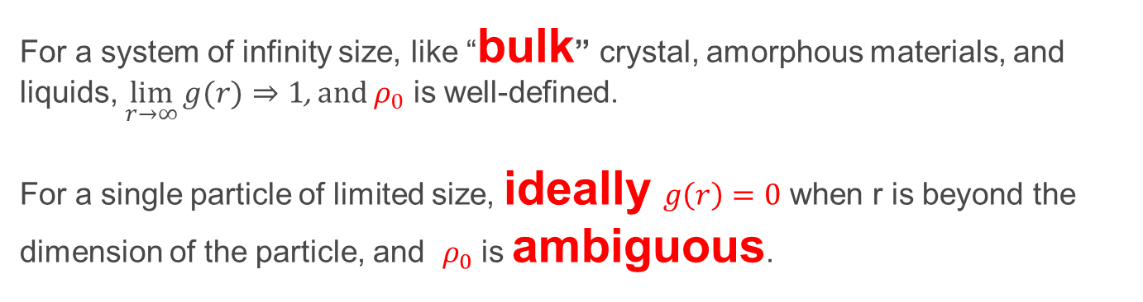
PDF for single particle scattering
Given that the molecules are random and isotropically oriented in solution:
$$δ\left(A\right)=\left\{\begin{aligned}1 when 0 ⊆A \\ 0 when 0 ∉A\end{aligned}\right.$$
$$g\left(r\right)=\frac{1}{4πr^{2}Nρ_{0}}\int{\sum_{i}{\sum_{j≠i}{\frac{b_{i}b_{j}}{{\left\langle b\right\rangle }^{2}}δ(r−r_{ij})}}}dr$$
Pair Distribution Function
Histogram of Atomic Distance
$ρ_{0}$ : Number density of atoms
For a system of infinity size, like “bulk” crystal, amorphous materials, and liquids, $\lim_{r→∞}{g(r)}⇒1$, and $ρ_{0}$ is well-defined.
For a single particle of limited size, ideally $g\left(r\right)=0$ when r is beyond the dimension of the particle, and $ρ_{0}$ is ambiguous.

Slide 41
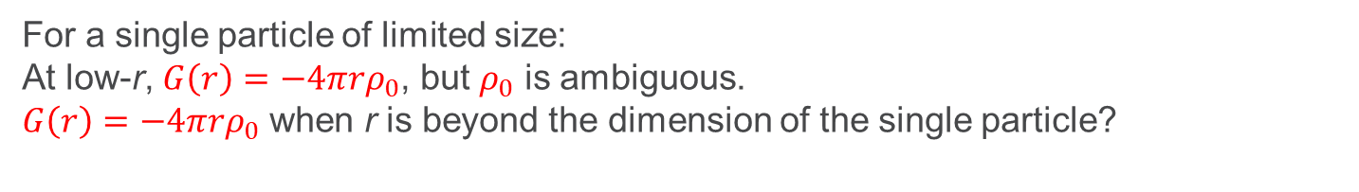
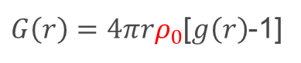
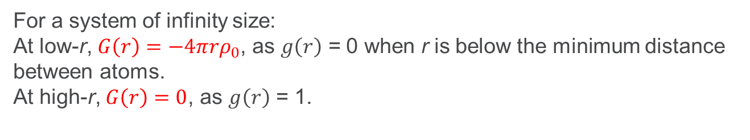
PDF for single particle scattering
$G\left(r\right)=4πrρ_{0}$[$g\left(r\right)$-1]
Reduced Pair Distribution Function
Derivation of averaged atomic number density
For a system of infinity size:
At low-r, $G\left(r\right)=−4πrρ_{0}$, as $g\left(r\right)$ = 0 when r is below the minimum distance between atoms.
At high-r, $G\left(r\right)=0$, as $g\left(r\right)$ = 1.
For a single particle of limited size:
At low-r, $G\left(r\right)=−4πrρ_{0}$, but $ρ_{0}$ is ambiguous.
$G\left(r\right)=−4πrρ_{0}$ when r is beyond the dimension of the single particle?

Slide 42
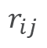
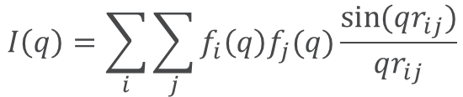
PDF for single particle scattering
Debye scattering equation:
$$I\left(q\right)=\sum_{i}{\sum_{j}{f_{i}{\left(q\right)f}_{j}(q)\frac{\sin{(qr_{ij})}}{qr_{ij}}}}$$
$$r_{ij}$$
The distance between atoms i and j
$$f(q)$$
Atomic scattering factor
For a single particle in solution, the scattering can be separated as
the scattering from particle.
the scattering from r beyond the dimension of the particle size, which is the cross-correlation from the particle and solvent.
the scattering from solvent, which has been subtracted during the data reduction.

Slide 43
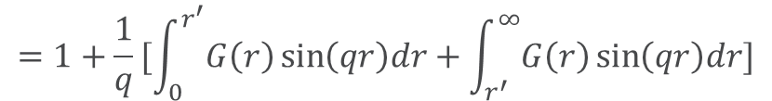
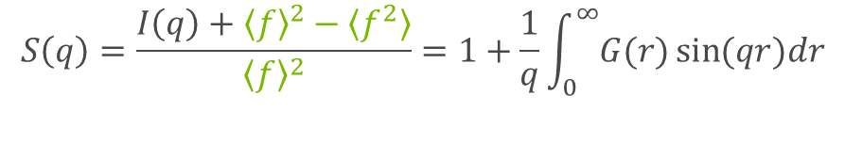
Laue monotonic scattering, to normalize I(q) to ${\left\langle f\right\rangle }^{2}$at high q
$$S\left(q\right)=\frac{I\left(q\right)+{\left\langle f\right\rangle }^{2}−\left\langle f^{2}\right\rangle }{{\left\langle f\right\rangle }^{2}}=1+\frac{1}{q}\int_{0}^{∞}{G(r)\sin{(qr)dr}}$$
$$=1+\frac{1}{q}[\int_{0}^{r^{′}}{G\left(r\right)\sin\left(qr\right)dr}+\int_{r^{′}}^{∞}{G\left(r\right)\sin\left(qr\right)dr]}$$
Does not converge!!
Normalized scattering intensity from the particle minus excluded solvents

Slide 44
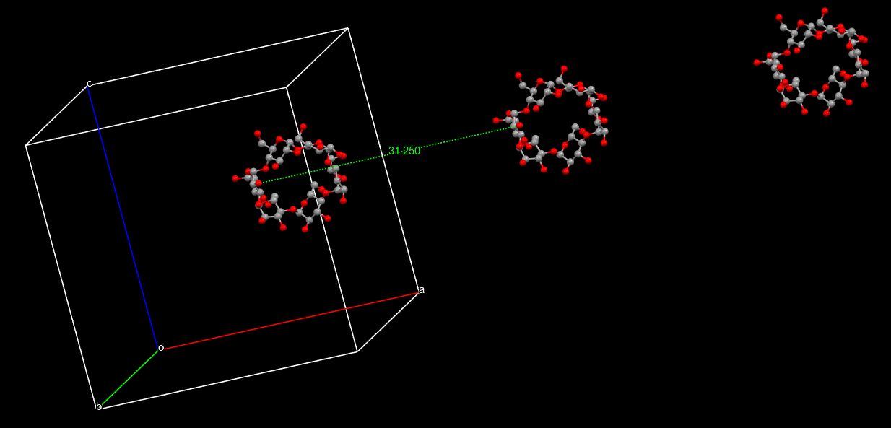
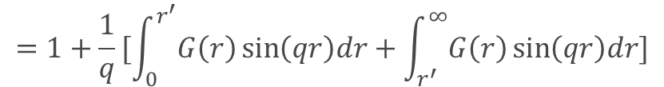
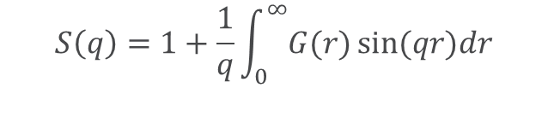
Assuming inter-particle correlation and the correlation between the medium (solvents) and the particle is negligible.
$$S\left(q\right)=1+\frac{1}{q}\int_{0}^{∞}{G(r)\sin{(qr)dr}}$$
$$=1+\frac{1}{q}[\int_{0}^{r^{′}}{G\left(r\right)\sin\left(qr\right)dr}+\int_{r^{′}}^{∞}{G\left(r\right)\sin\left(qr\right)dr]}$$
The scattering from solvents can be totally subtracted, and no intensity contribution from the cross-term between solvents and particle.
Then, the space beyond the dimension of the particle can be treated as vacuum.

Slide 45


$$S\left(q\right)=1+\frac{1}{q}\int_{0}^{∞}{G(r)\sin{(qr)dr}}$$
$$=1+\frac{1}{q}[\int_{0}^{r^{′}}{G\left(r\right)\sin\left(qr\right)dr}+\int_{r^{′}}^{∞}{G\left(r\right)\sin\left(qr\right)dr]}$$
$$=1+\frac{1}{q}[\int_{0}^{r^{′}}{G\left(r\right)\sin\left(qr\right)dr}−4πρ_{0}\int_{r^{′}}^{∞}{r\sin\left(qr\right)dr]}$$
The space beyond the dimension of the particle, vacuum.
$g\left(r\right)=0$ $G\left(r\right)=4πrρ_{0}$[$g\left(r\right)$-1]= $−4πrρ_{0}$
Still does not converge!!

Slide 46


$$S\left(q\right)=1+\frac{1}{q}\int_{0}^{∞}{G(r)\sin{(qr)dr}}$$
$$=1+\frac{1}{q}[\int_{0}^{r^{′}}{G\left(r\right)\sin\left(qr\right)dr}+\int_{r^{′}}^{∞}{G\left(r\right)\sin\left(qr\right)dr]}$$
$$=1+\frac{1}{q}[\int_{0}^{r^{′}}{G\left(r\right)\sin\left(qr\right)dr}−4πρ_{0}\int_{r^{′}}^{∞}{r\sin\left(qr\right)dr]}$$
The space beyond the dimension of the particle is vacuum.
$ρ_{0}$= 0
The second term becomes 0
$$=1+\frac{1}{q}\int_{0}^{r^{′}}{G\left(r\right)\sin\left(qr\right)dr}$$
Normalized scattering intensity from the particle minus excluded solvents

Slide 47
Alpha CD @ 12-ID-B

Slide 48
Alpha CD
G(r) Extracted from Simulated and Experimental I(q) Data
The simulated one from a structure without Debye-Waller factor and hydration layer
Sharper peaks, lower peak area at 2.8 Å (Oxygen-Oxygen distance in a hydrogen bond), and no features beyond 12 Å (hydration layer).

Slide 49
Heparin structure
Heavily charged, semi-rigid polysaccharide chain
PDB entry 3IRJ, structure determined by SAXS, 0.5 mg/ml

Slide 50
Heparin scattering data
125 mg/ml Heparin sodium salt aqueous solution
M_{w} ~ 20KDa

Slide 51
PDDF analysis and Kratky plot
PDDF
Kratky Plot
The polysaccharide chain is most likely folded.

Slide 52
G(r) profiles
The G(r) profiles also shows huge difference between experimental extracted profile and the profile calculated from semi-rigid chain model.
Initial Model
50

Slide 53
Heparin structural refinement
Define each saccharide ring as a rigid body and allow torsion angle to change between the rings.
Simulated annealing: Monte Carlo simulation on torsion angles until the G(r) profile matches

Slide 54
0.087 atoms/Å³
1156 atoms (with crystalline water): 13287 Å³
1012 atoms (without crystalline water): 11632 Å³
Excluded volume from crysol: 12520 Å³

Slide 55
0.087 atoms/Å³
1156 atoms (with crystalline water): 13287 Å³
1012 atoms (without crystalline water): 11632 Å³
Excluded volume from crysol: 12520 Å³
0.075 atoms/Å³
1156 atoms (with crystalline water): 15413 Å³
1012 atoms (without crystalline water): 13493 Å³
Excluded volume from crysol: 12520 Å³
0.088 atoms/Å³
1156 atoms (with crystalline water): 13136 Å³
1012 atoms (without crystalline water): 11500 Å³
Excluded volume from crysol: 12520 Å³

Slide 56


What is the PDF?
2.47 Å
2.47 Å
2.47 Å
1.42 Å
2.47 Å
1.42 Å
1.42 Å
1.42 Å
1.42 Å
Probability of finding a pair of atoms at various distances
3.76 Å
3.76 Å
2.83 Å
2.83 Å
4.27 Å
2.83 Å
3.76 Å
1.42 Å
2.47 Å
2.83 Å
4.27 Å

Slide 57

The Pair Distribution Function, G(r)
- a weighted histogram of ALL atom-atom distances
Providing valuable structural insight for:
Nanoscale materials
Disordered materials
Liquids, gases
Vacancies, impurities, interstitial atoms

Slide 58

The Pair Distribution Function, G(r)
Direct extraction of parameters from PDF (peak fitting)
Peak Position Atomic distances
A
Peak Position
Peak Area
Peak Width
Peak r_{max}
Atomic distances
Coordination number
Disorder
Particle size, coherence
C
B
A
C
B

Slide 59
The Pair Distribution Function, G(r)
Peak Area Number of pairs weighted by scattering power
i.e. coordination number &/or concentration
A
Peak Position
Peak Area
Peak Width
Peak r_{max}
Atomic distances
Coordination number
Disorder
Particle size, coherence
C
12 neighbors
B
12 neighbors
A
C
6 neighbors
B

Slide 60

The Pair Distribution Function, G(r)
Peak Width Disorder
A
Peak Position
Peak Area
Peak Width
Peak r_{max}
Atomic distances
Coordination number
Disorder
Particle size, coherence
C
C
B

Slide 61

The Pair Distribution Function, G(r)
Peak r_{max} Particle size, coherence
Peak Position
Peak Area
Peak Width
Peak r_{max}
Atomic distances
Coordination number
Disorder
Particle size, coherence
r_{max}

Slide 62





PDF vs Coherence
Crystalline well ordered
Crystalline disordered
Nanomaterial
Amorphous

Slide 63


For more information
“Underneath the Bragg Peaks” 2nd Ed. (2012)
Takeshi Egami & Simon J.L. Billinge
Toby, B.H. and T. Egami, (1992) Accuracy of Pair Distribution Function-Analysis Applied to Crystalline and Noncrystalline Materials. Acta Cryst. A, 48: p. 336-346.

Slide 64







Data Reduction Process
1. Collect 3D data
2. I(Q) Integration
+ background correction
3. Calculate S(Q)
6. Data Analysis / Modeling
5. Fourier transform to get G(r)
4. Calculate F(Q)

Slide 65

Local coordination geometry: EXAFS vs. PDF
EXAFS (r < 6 Å)
Atomic scale resolution over a few coordination shells
Bond lengths available after correcting for phase shift
Intrinsically element specific
Elements must have edge at appropriate energy
PDF (r >> 6 Å)
Atomic scale resolution over many coordination shells, > 100Å
Bond lengths correspond directly to peak position
Not element specific. Sees all (but we can recover chemical specificity)
Pt foil Pt L₃-edge
Data in ~0.03 sec
Vaarkamp et al. PRB 1994 7872
r / Angstrom

